Slide 1
JSP Fundamentals

Slide 2

Module Overview
Creating First JSP Page
Expression Tag Declaration Tag Scriptlet Tag

Slide 3

Demo
Creating First JSP Page – Hello World

Slide 4
Expression Tag

Slide 5
Expression Tag
JSP Expression Tag are used to compute an expression and the result of that is included in HTML page that's returned to the Browser

Slide 6
<p> current date and time
<%=
// java code
%>
</p>

Slide 7
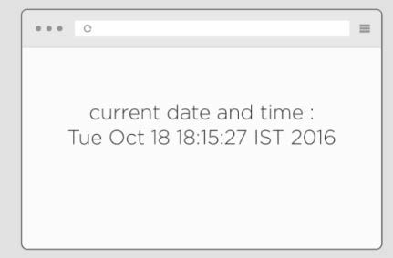
<p> current date and time
<%=
new java .util.Date()
%>
</p>

Slide 8
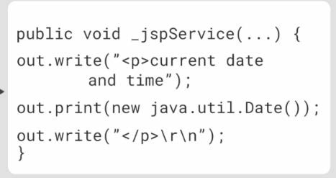
<p> current date and time
<%=
new java .util.Date() ----→
%>
</p>

Slide 9
Assisted Practice
Expression Tag

Slide 10
Declaration Tag

Slide 11
<%! %>
<%! int id =10;%>
<%! static String department="SALES":%>
<%! decimal getBonus(decimal salary)
{return salary*0.10;}"%>
Syntax
To define the Declaration Tag

Slide 12
Assisted Practice
Declaration Tag

Slide 13
Scriptlet Tag

Slide 14
Scriptlet Tag
Scripting Element which allows us to add any variable declarations and any computed logic with in the JSP page

Slide 15
Demo_ jsp.java
Demo.jsp
_ jspService(...) {
// Java Code Block1 ...
// Java Code Block2 ...
// Java Code Block3 ...
<% // Java Code Block1 %>
<% // Java Code Block2 %>
<% // Java Code Block3 %>
}

Slide 16
Demo_ jsp.java
Demo.jsp
<%! int id =10; decimal getBonus(decimal salary){return salary*0.10;}
%>
<%
double Salary=5000 annualSalary=Salary*12;
%>
int id =10; decimal
getBonus(decimal salary)
{return salary*0.10;}
_ jspService(...)
{ double Salary=5000
annualSalary=Salary*12; }

Slide 17
Assisted Practice
Scriptlet Tag

Slide 18
Summary
Creating First JSP Page
Expression Tag Declaration Tag Scriptlet Tag

